Slide 1
Billing
August 2018
Notes:
Default cover design.

Slide 2
Invoice List ( VEC 2.0 )
VEC
VECRM
Portal
User
Subscriber
VAM Cache out of sync
Missing & Invalid entitlements
New Users
Limited Scalability
XL Users unsupported
Large Users – Multiple retries
Cache rebuilt daily – First time is degraded experience
Invoices
VAM Tables
VAM / DB2 Mainframe
User / Subscriber /
Accounts
Wisegate
Portal
Subscriber / Accounts
GCH
Customer Hierarchy
{"Opco":"00698","AccountNumber_Display":"9733357398159","RemitAcctInd":"Y","SbOid":"0015784998.","InvoiceDate":"2018-08-26", "CorpGroup_Display":"9733357398159", "ServiceType":"BTN","GBR":"","Aban":"","OrigSystemId":"13","PaperStatus":"2","VesLarge":"N","ManBillDate":"2018-08-26", "Currency":"USD","CorpGroup":"9733357398159", "AccountType":"LEC", "SpOid":"0002630169.", "AddrCity":"PHOENIX,","DueDate":"2018-09-20","AccountNumber":"9733357398159","InvoiceNumber":"", "PreviousCharges":"67.97", "CurrentCharges":"67.97","PartialInd":"N","AccountName":"ADT LLC","NewAccountNumber":"","AccountAlias":"","StartPage":"5200","AddrState":"AZ","Wtn":""}

Slide 3
Invoice List ( 1D)
VEC
Portal
VAM / DB2 Mainframe
Portal
Customer Hierarchy
{ account_number:'U0129907', account_name:'UAT-Aug16-USA-000', invoice_number:'Z5955945',service_type:'BTNE2EI',account_type:'', aban:'Z5955945', orig_system_id:'PO', backend_system:'PRIMEBILG', paper_status:'0', currency:'USD', corp_group: '00106735CG', addr_city: 'GRAND PRAIRIE', due_date: '2017-10-01', addr_state:'TX', disp_man:'U0129907', disp_ban:'U0129907', opco:'00222', gbr:'', remit_acct_ind: 'Y', partial_ind: 'N', cust_acct_num: 'U0129907', invoice_date: '2017-09-01', man_bill_date:'2017-09-01', previous_charges: 0.00, current_charges: 1480.74, creation_date: '2018-07-02 16:51:53.689' }

Slide 4
Current VAM Interactions
Portal Billing
Invoices
Reports
Historical
Payments
Inquiry List
Profiles
Reporting Structure
Create Inquiry
Wisegate Account Level Entitlement check
Framework (Over 200K )
Stored Proc
VAM / DB2 Mainframe
Stored Proc
SQL
VAC Tables
VAM Tables
VAM Tables
Archive Tables
Portal Tables
Account Sync
CNP
Wisegate
GCH

Slide 5

External Systems
Portal
Billing
Online
VAM
Batch
VAC
Document
Archive
EPAY
CMS/SSP
BARS
X5/CABS CSR

Slide 6
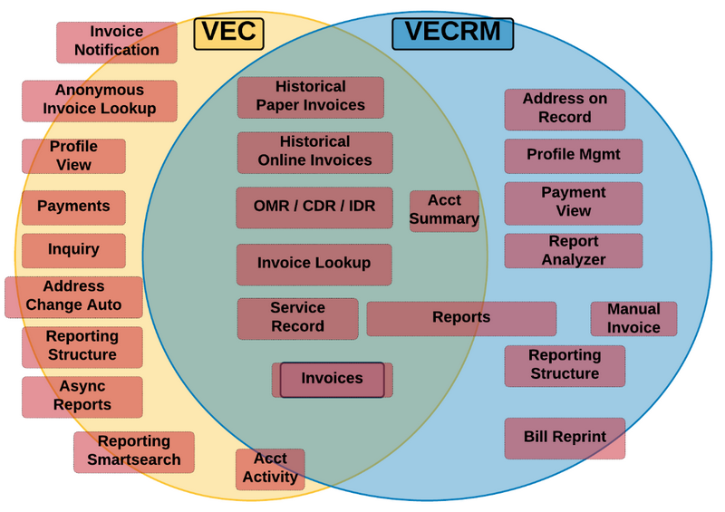
VEC/VECRM - Billing

Slide 7
VAM and Portal Billing
Notes:
Vz450 Statistics
Volume: >1,600 files; ~8B records / month
Revenue: $7.5B in billed revenue / month
Customers: 2.6M accounts per month
Source Systems: 29 billing applications
VAM Statistics
Database Size: 17 TB, 400 tables
Billed Data: 5B Vz450 records / month
Online Transactions: 1.5M / month
Billers generate invoice, usage, inventory, and revenue data in Vz450 Verizon standard format
VAM provides centralized repository and integrated services:
Online access to account and billing data
Reporting and analytics
Bill consolidation
Vz450 data drives:
Integrated Bill Inquiry (iCI)
Global Billing Reporting
Billing Portals
Electronic Billing
Print formatting
Standardized data warehouse
Financial reporting

